Slide 1
Muzix Application
Presented By:
NIKHIL SHRIVASTAVA,
MOHAMMAD KAMRAN,
RAGHUNATH M

Slide 2
Introduction
Our Muzix application is nothing but a movie application.
This app is designed to see all the movies of various languages & genres.
This app uses a 3rd party API to fetch the movies.
This app is compatible with all devices like Desktop, Tablet, Mobile, etc…
In our app all movies are present including the latest movies .

Slide 3
Features of the App
See the movie info.
Search Any Movie.
Add to Favourites.
Delete from Favourites.
Recommended movies related to particular movie.

Slide 4
Tools & Technologies
BackEnd
Spring Boot
Eureka Server
API Gateway
Feign Client
RabbitMQ
Docker
FrontEnd
Angular
Databases
MongoDB
MySQL

Slide 5
Spring Boot
Spring Boot is an open source Java-based framework used to create a micro Service.
It is developed by Pivotal Team and is used to build stand-alone and production ready spring applications.

Slide 6
Eureka Server
Eureka Server is an application that holds the information about all client-service applications.
Every Micro service will register into the Eureka server and Eureka server knows all the client applications running on each port and IP address.
Eureka Server is also known as Discovery Server.

Slide 7
Spring Cloud API Gateway
An API stands for Application Program Interface. It is a set of instructions, protocols, and tools for building software applications. It specifies how software components should interact.
The API Gateway is a server. It is a single entry point into a system.
API Gateway encapsulates the internal system architecture.
API Gateway allows us to route API request (external or internal) to connect services.
It also provides a library for building an API gateway on the top of Spring MVC.
Its aims to provide cross-cutting concerns to them, such as security and monitoring.

Slide 8
Feign Client
The Feign is a declarative web service (HTTP client) developed by Netflix. Its aim is to simplify the HTTP API clients. It is a Java to HTTP client binder. If you want to use Feign, create an interface, and annotate it. It provides pluggable annotation support, including Feign annotations and JAX-RS annotations.
It is a library for creating REST API clients. It makes web service clients easier. The developers can use declarative annotations to call the REST services instead of writing representative boilerplate code.

Slide 9
RabbitMQ
RabbitMQ is an open source message broker software. It accepts messages from producers, and delivers them to consumers.
It acts like a middleman which can be used to reduce loads and delivery times taken by web application servers.

Slide 10
Docker
Docker is an open source platform for building, deploying, and managing containerized applications.
It enables developers to package applications into containers—standardized executable components combining application source code with the operating system (OS) libraries and dependencies required to run that code in any environment. Containers simplify delivery of distributed applications

Slide 11
Angular
Angular is a platform and framework for building single-page client applications using HTML,CSS and TypeScript.
It implements core and optional functionality as a set of TypeScript libraries that you import into your applications.

Slide 12
MongoDB
MongoDB is a very popular open-source Document Database that operates as a NoSQL database.
It is popularly used in collaboration with AWS, Azure, and many other data sources for application development and functioning
It provides, high performance, high availability, and easy scalability.
MongoDB works on concept of collection and document.

Slide 13
MySQL
MySQL is a relational database management system based on the Structured Query Language, which is the popular language for accessing and managing the records in the database.
MySQL is open-source and free software under the GNU license.
It is supported by Oracle Company.

Slide 14
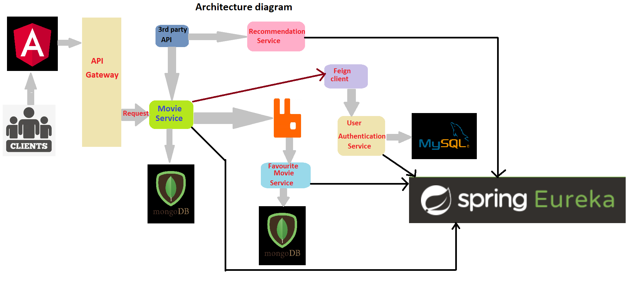

Slide 15
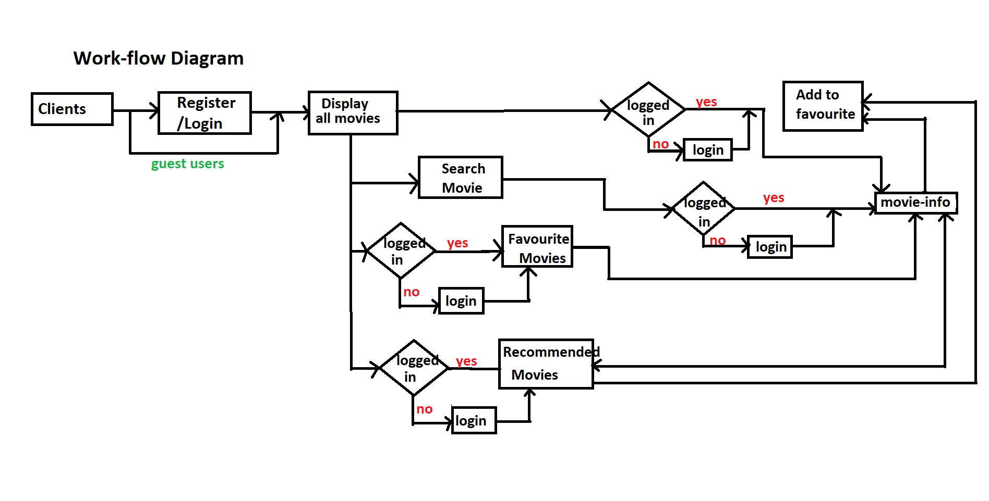

Slide 16
Thank You

